Slide 1
Book reader for blind people
Group - 4
Members :
Muhammad Zubair Hasan (201714041)
Shariar Azad (201714037)
Nazifa Hamid Rafa (201714044)
Takik Hasan (201714038)
Shahir Abdullah (201714054)

Slide 2
Project idea and feasibility
This project is a text to speech based book reading system for blind people
In many cases it is found that blind students don’t find their books in brail which makes it difficult for them to study
Even for normal blind people who wants to enjoy book reading , often find themselves in hardship because of their unavailability
Currently they are quite a few book reading systems in the market but they are very expensive
Our goal is to cut the cost of the system drastically to make it available for everybody

Slide 3
MARKET ANALYSIS
Project Name | Features
 | Hear Books | Adjust Voice Speed | Portability | Multilanguage Reading | Cheap | AI based
Eye – Snap Reader | ✓ | ✓ | ✖ | ✖ | ✖ | ✖
I – reader desktop scanner | ✓ | ✓ | ✓ | ✖ | ✖ | ✖
Eye – Scan Reader | ✓ | ✓ | ✖ | ✖ | ✖ | ✖
Our Project | ✓ | ✓ | ✓ | ✓ | ✓ | ✓

Slide 4
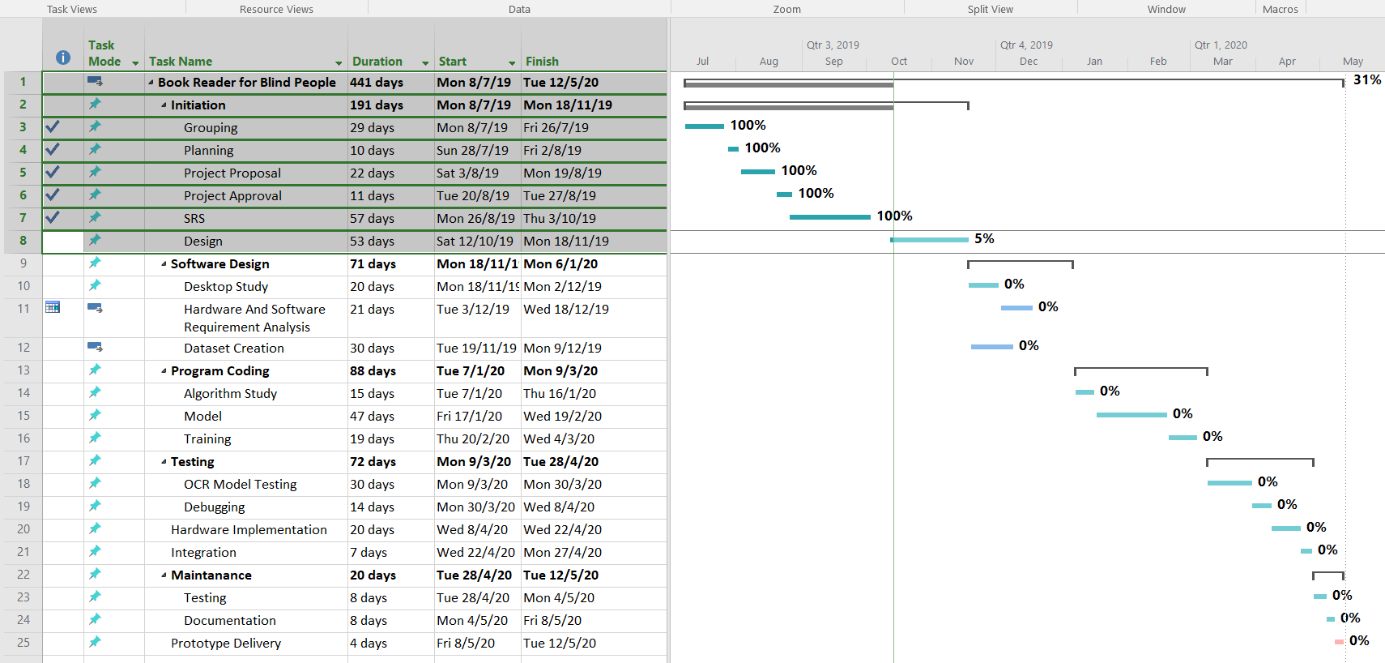
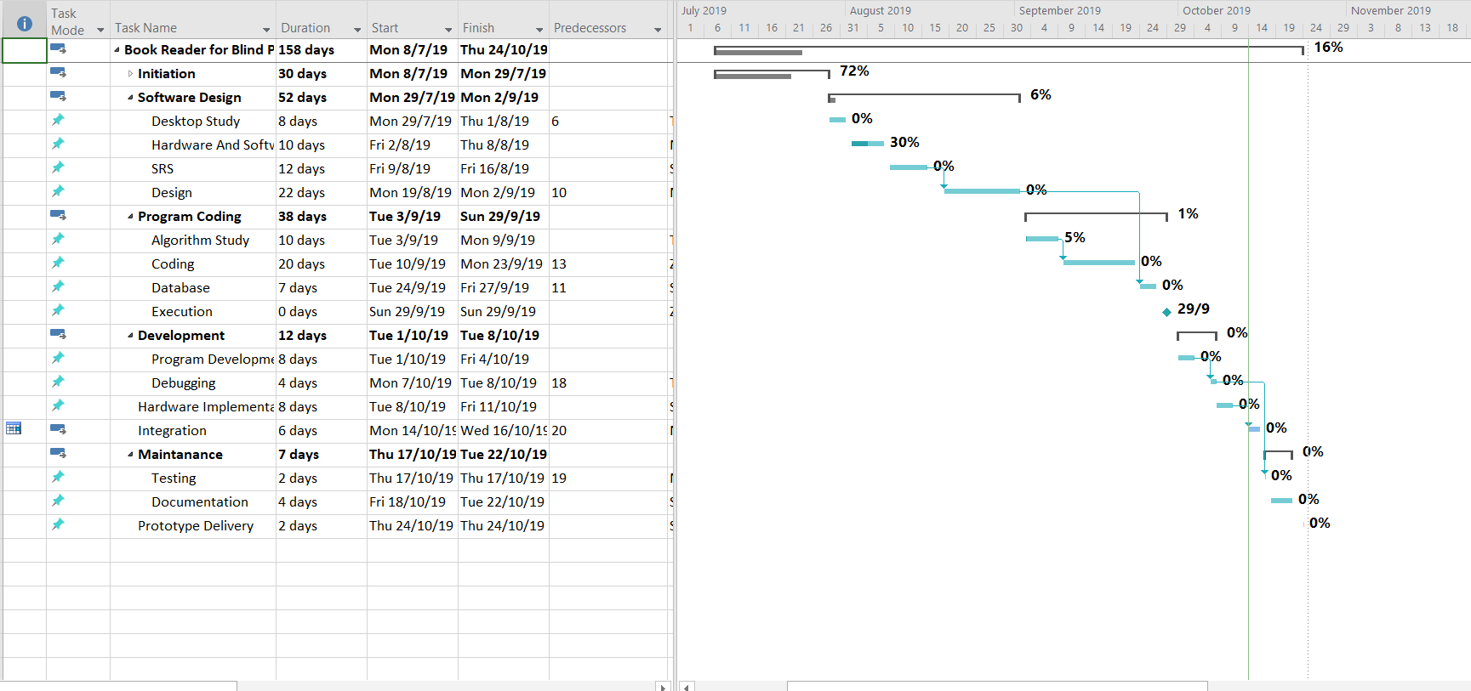
Project plan
Role of members :
Zubair: Data Collection and Dataset creation
Takik & Shahir : Text to Speech
Nazifa & Shariar : OCR Mode

Slide 5
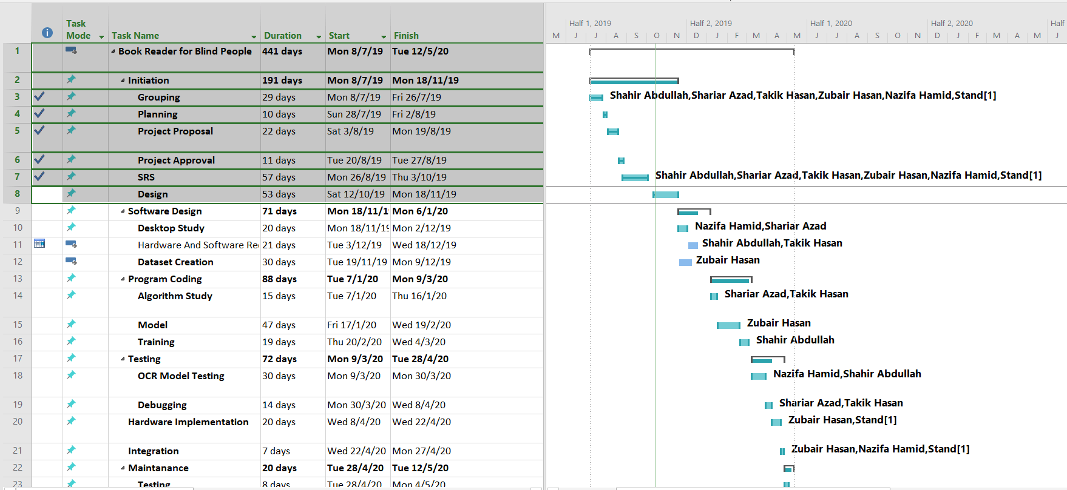
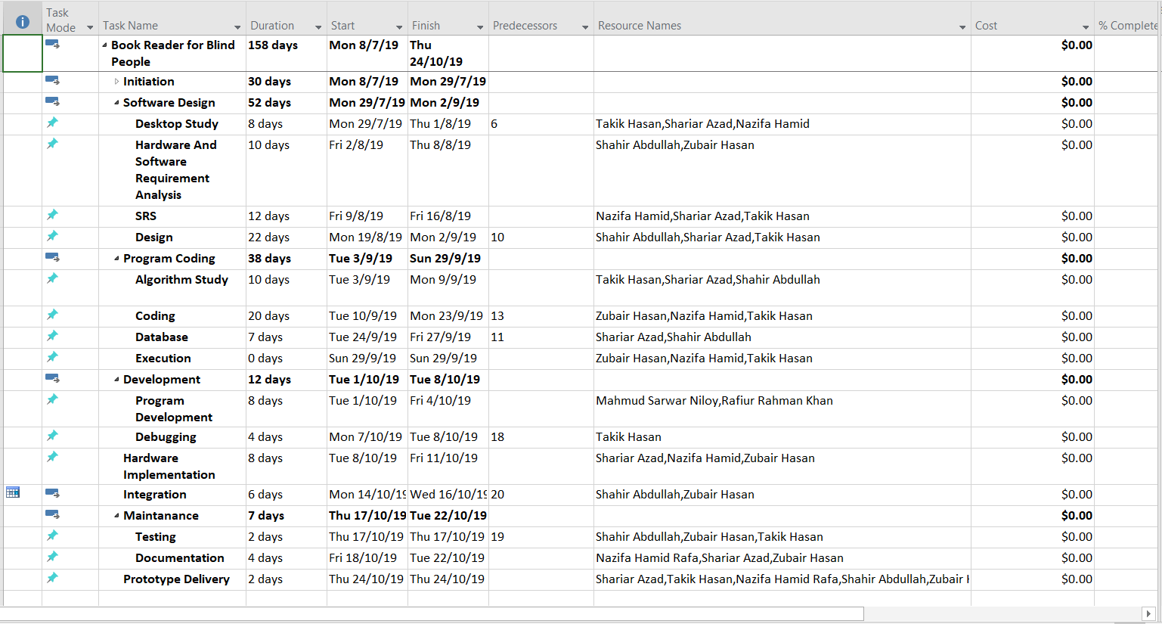
Deadline and deliverables

Slide 6
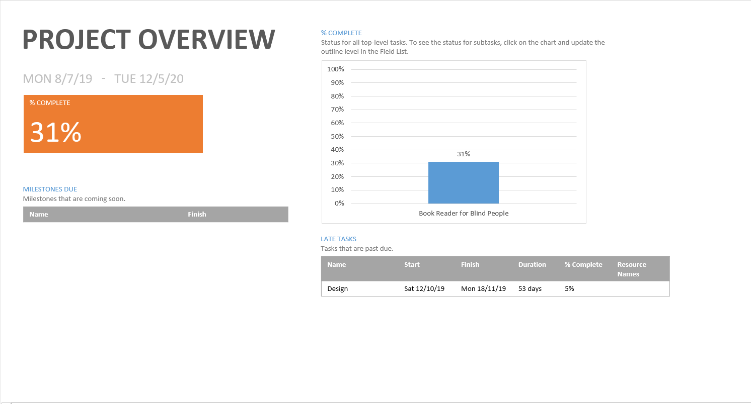

Slide 7
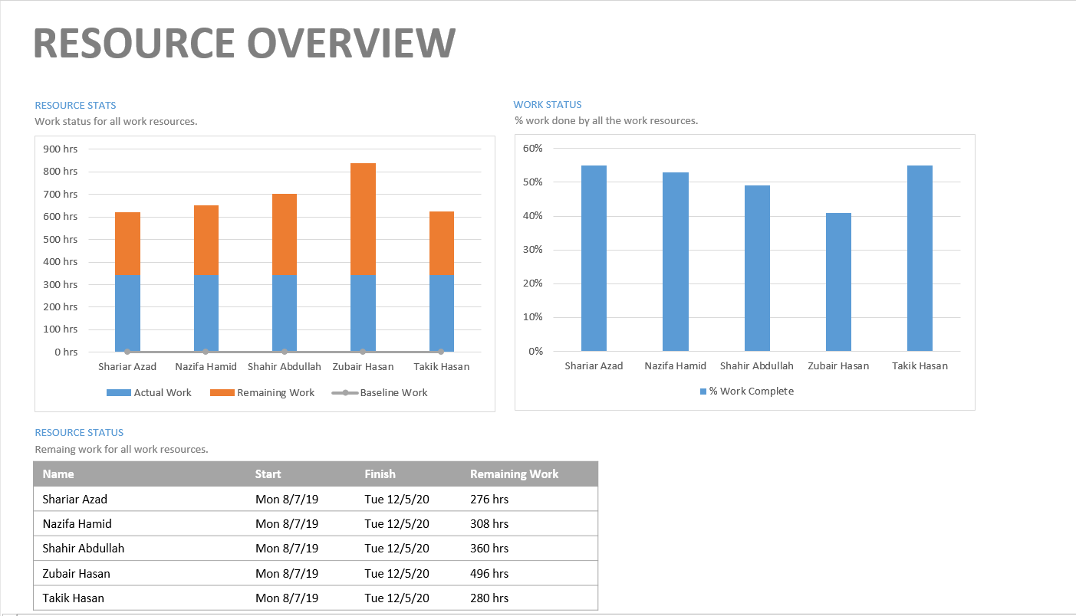

Slide 8
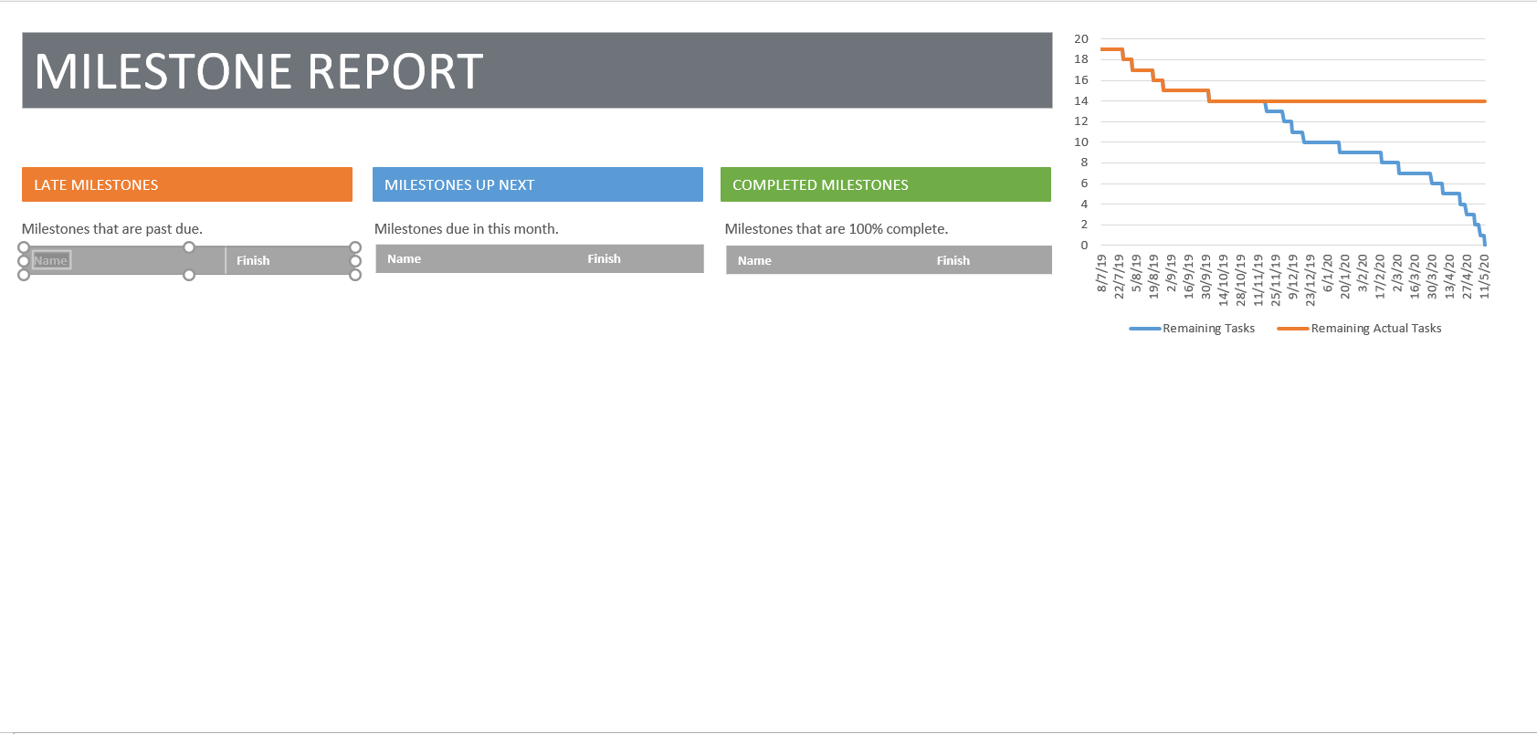

Slide 9
Stakeholders
Type | Name | Role
Internal | Developer | Collecting data, creating models and maintaining the software.
Internal | Faculty | Giving guidance and knowledge to the developers.
Internal | MIST Authority | Providing administrative support and collaborating with organizations helping the blind people.
External | Software tester | Testing dependibility and accuracy of the software and reporting bugs.
External | Blind people | Main user of the program.

Slide 10
System requirement specifications
1.User Should be able to place any type of book.
  An adjustable book stand on which variable size books will be placed.
2.There should be feedback for the end of page.
  A voice will indicate the end of page
3.The voice from the speaker should be audible.
  User will change volume with the phone by volume button or by app UI

Slide 11
System requirement specifications
4.Setting Reading Speed
  A button will be mapped for setting reading speed
5.Reading initiation feedback
  Voice confirmation to start reading.
6.Voice command
  The entire app can be navigated through voice commands like going to next page,
  Stop reading, changing volume etc.

Slide 12
Requirement classification
Serial | User Requirements | Types of Requirements ( Functional ) | Types of Requirements ( Non Functional )
1. | Placing any types of books | ✔
2. | Cursor detection | ✔ | ✔
3. | Voice audibility | ✔ | ✔
4. | Setting reading speed | ✔
5. | Reading initiation feedback | ✔ | ✔
6. | Voice command | ✔

Slide 13
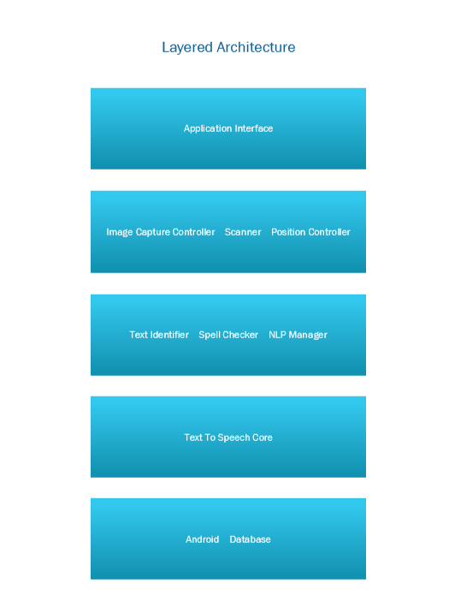
System architecture

Slide 14
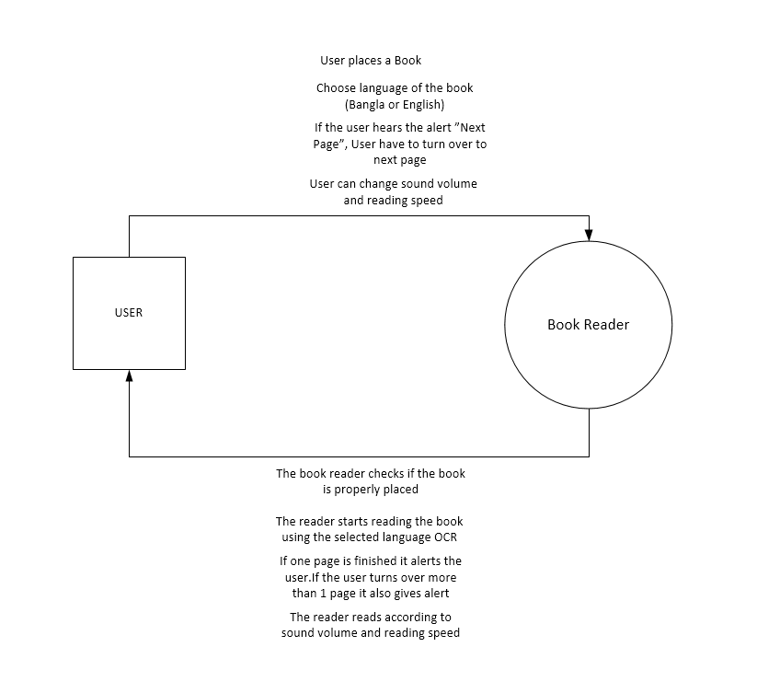
Graphical representation
context diagram

Slide 15
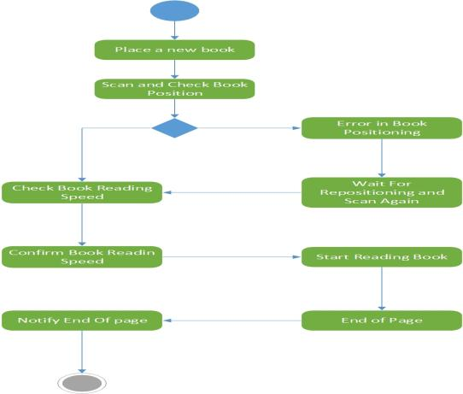
Activity diagram

Slide 16
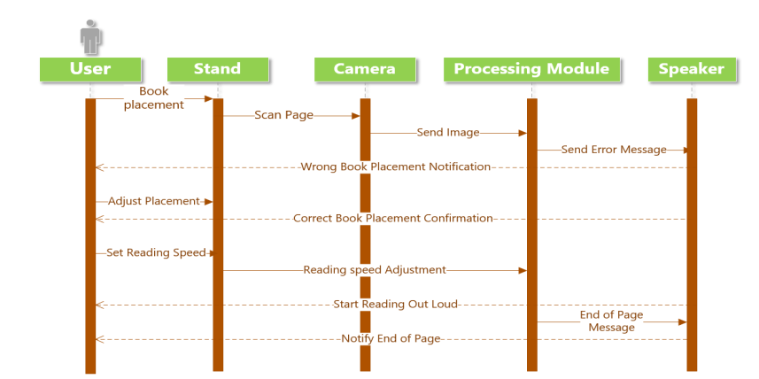
Sequence diagram

Slide 17
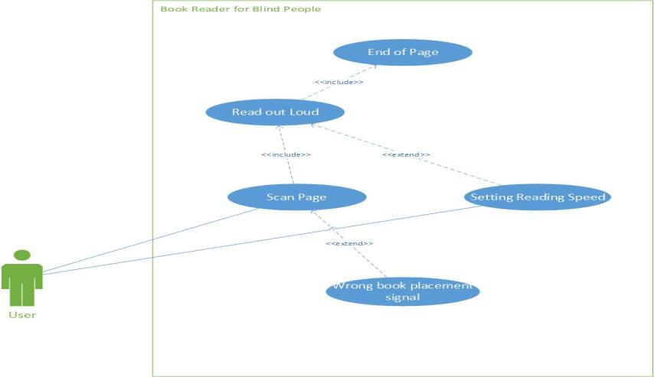
Use case diagram

Slide 18
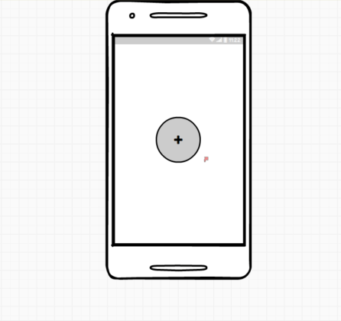
Project prototype

Slide 19
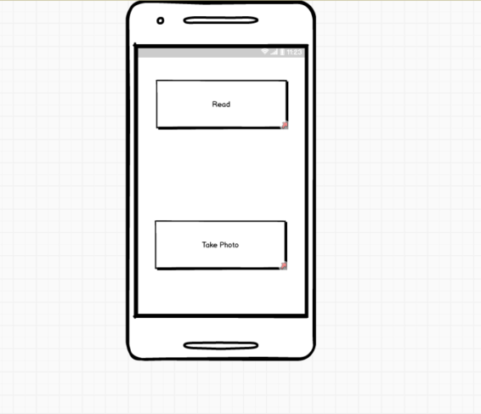
Project prototype

Slide 20
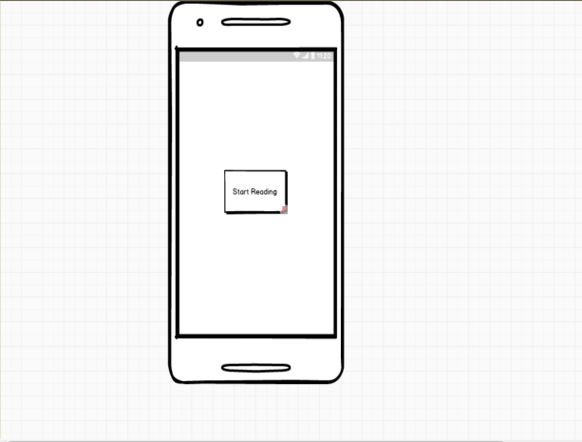
Project prototype

Slide 21
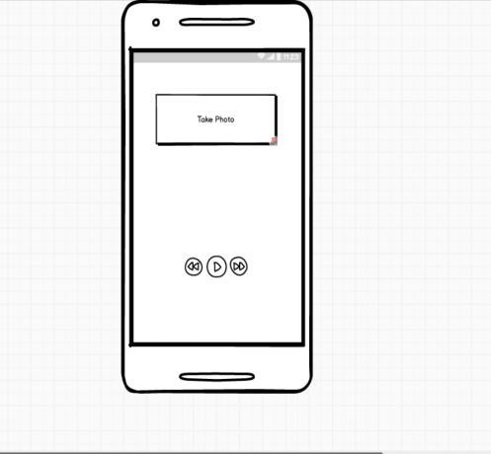
Project prototype

Slide 22
IMPLEMENTATION
Algorithm Comparison
Convolutional Neural Network
Recurrent Neural
Network
- Used for classifying different graphemes of text
- Resnet34 pretrained model is used
- Used for outputting different text from image
- LSTM architecture is used for better perfomance

Slide 23
Project Roadmap
CNN model pretrained with resnet34
LSTM model that uses the CNN model to output text
Mapping Bangla graphemes to English graphemes
Generate audio with "Google text to speech"

Slide 24
CNN Model pretrained with resnet34
We utilize transfer learning to improve our performance on Kaggle Bengali.Ai handwritten Bangla dataset. The model will correctly predict the grapheme of individual words

Slide 25
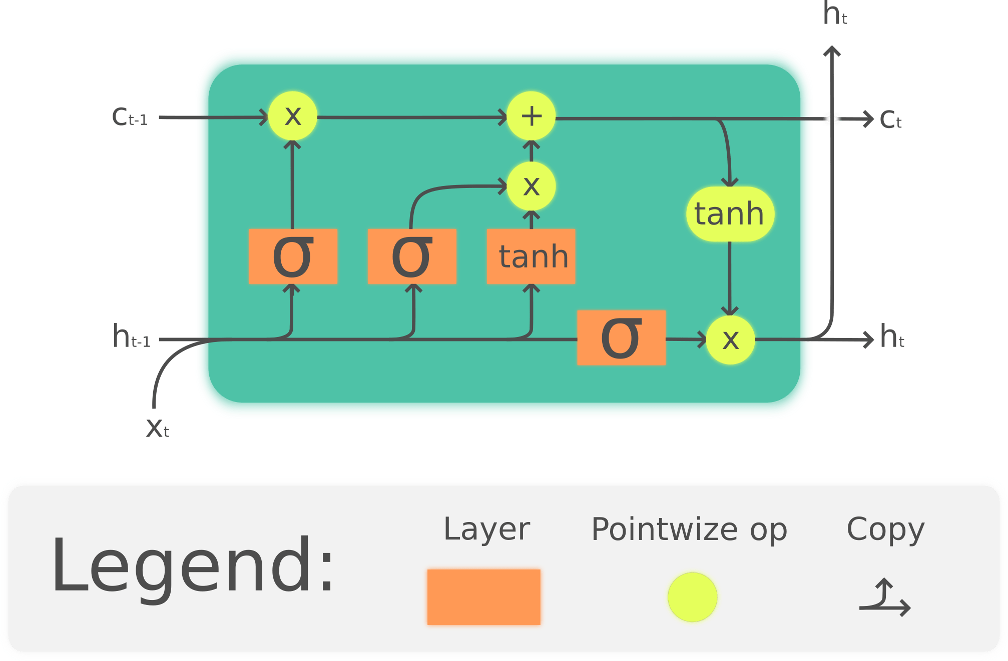
LSTM Model

Slide 26
Map Bangla Graphemes to English Graphemes
To use google TTS service we will map the Bangla unicode strings from the LSTM network to an English ANSI string. This will be used for generating final speech

Slide 27
Google Text To Speech
Google text to speech API will be used for accurate speech generation.

Slide 28
QUESTIONS ??

Slide 29
Bangla Book Reader For The Blind
Group No : 4 (B)
Members :
Muhammad Zubair Hasan (201714041)
Shariar Azad (201714037)
Nazifa Hamid (201714044)
Takik Hasan (201714038)
Shahir Abdullah (201714054)

Slide 30

Objective
To build a device that can read text out loud from any printed book for the blind or visually impaired, by:
i. Taking picture of the text document with a camera placed on the stand.
ii. Extracting the text from the document.
iii. Converting extracted text to speech.
iv. Controlling speed, volume of the speech and navigation with user input through external buttons.

Slide 31
Features
• Simplicity
• Speed
• Variable playback speed
• Variable playback volume
• Portable
• User friendly
• Cost efficient

Slide 32
Target users and Contribution of the system
This project is a text to speech based book reading system for blind people
In many cases it is found that blind students don’t find their books in brail which makes it difficult for them to study
Even for normal blind people who wants to enjoy book reading , often find themselves in hardship because of their unavailability
Currently they are quite a few book reading systems in the market but they are very expensive
Our goal is to cut the cost of the system drastically to make it available for everybody

Slide 33
Project Plan
Milestone Number | Title | Forecast date
1 | Project Approval Completion | Mon 9/3/20
2 | Software Design Completion | Mon 9/12/20
3 | Program Coding and Model Training Completion | Wed 4/3/20
4 | Testing Completion | Mon 27/4/20
5 | Documentation Completion | Thurs 1/14/21
6 | Deployment Completion | Mon 1/11/21
7 | Project Completion | Thurs 1/21/21

Slide 34
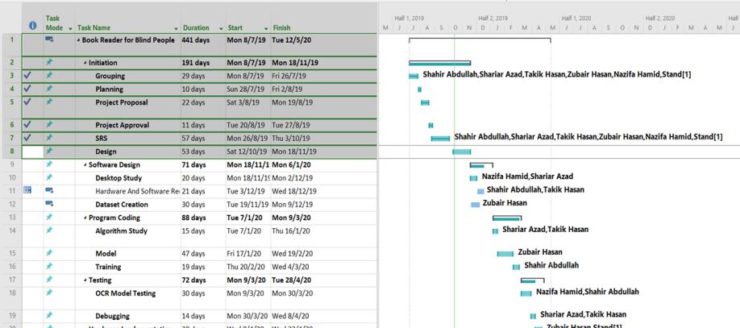
Gnatt chart

Slide 35
Dataset
We built a custom dataset for training the text recognition model
The dataset was hand labeled and consists of 934 classes and 2452 training images
Google AI Bengali text to speech dataset was used for text to speech conversion

Slide 36
System Flow Diagram
Arduino
Ask Server For Audio(Android)
Process Audio File
Send Audio
Convert Audio for Android
Take Photo
Play Audio
Upload Button
Go to Homepage Button
Run Audio
Send Completion Response
Send Image to Server(Android)
Process Image
Run Classifier
Generate Audio
Store Audio
Go to Application Homepage(Android)
Open Camera(Android)
Save Photo in Device(Android)
Encode Image to Base64(Android)

Slide 37
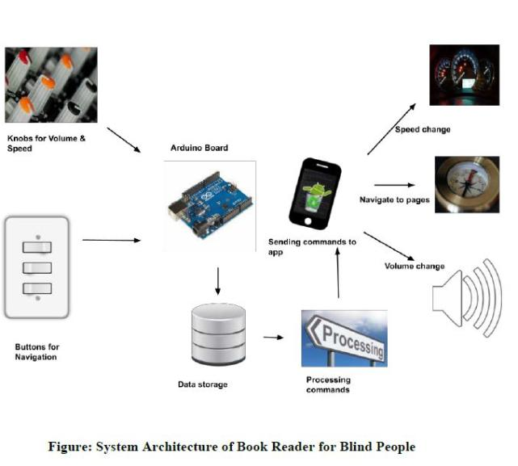
System Architecture

Slide 38
System Requirements
Serial | User Requirements | Types of Requirements ( Functional ) | Types of Requirements (Non-Functional )
1. | Placing any types of books | ✔
2. | Extracting the text from the document. | ✔
3. | Converting extracted text to speech. | ✔
4. | Correctness and voice audibility | ✔ | ✔
5. | Setting reading speed | ✔
6. | Voice command | ✔
7. | Internet server connection |  | ✔
8. | Taking Proper image of the document |  | ✔

Slide 39
Software Testing
  FEATURES TO BE TESTED
  1. Server System:
  Criteria Assessment: Security, Response time
  Testing Type: Unit testing.
  2. Android Application:
  Criteria Assessment: Usability
  Testing Type: Unit Testing.
  3. Server Image Receive and Processing from Android:
  Criteria Assessment: Performance, Response time
  Testing Type: Integration Testing.
  4. Server Send Audio File to Android:
  Criteria Assessment: Performance, Response time
  Testing Type: Integration Testing.
  5. Whole System test:
  Criteria Assessment: Performance, Response time, Model Accuracy, Usability
  Testing Type: System Testing.

Slide 40
Software Testing (Outcome)
Test Name | Test Type | Pass/fail Criteria | Average Response Time
Server System | Unit testing | <30s | 20s
Application System | Unit testing | <10s | 5s
Server Image Receive and Processing from Android | Integration testing | <200s | 184s
Server Send Audio File to Android | Integration testing | <90s | 74s
Whole System test | System testing | <300s | 250s

Slide 41
Experimental Study
Task No. | Task Completion Time | Success/Fail | No. of Click Required Vs Expected | No. of Attempts | No. of Asking Help
Task 1 | 2s | Success | Required:1 Expected:1 | 1 | 0
Task 2 | 2s | Success | Required:1 Expected:1 | 2 | 0
Task 3 | 3 mins | Success | Required:1 Expected:1 | 2 | 1
Task 4 | 35s | Success | Required:1 Expected:1 | 2 | 1
Android Application
Task 1: Open camera
Task 2: Take the page picture
Task 3: Upload page picture
Task 4: Download and play audio

Slide 42
Pre- Questionnaires
Question | Answer | Participant Name
Have you used any kind of audio book reader system before and if yes rate the system ? | No | Muhammad Zubair Hasan (Student)
Do you think book reader systems are important for blind students? | Yes
What should be the price range for such book reader systems ? | Less than 2000 tk
Do you prefer the system to be portable ? | Yes
What type of blindness do you have ?

Slide 43
Data collection on the app
Question | Answer | Participant Name
Are the buttons easy to press? | Yes | Muhammad Zubair Hasan (Student)
Does the UI seem intuitive? | Yes
Was it hard to capture pictures using the camera app? | No
Was the feedback for button press easy to understand | Yes
Was the audio clear ? | No

Slide 44
Post-Questionnaires
Question | Answer | Participant Name
Do you like the portability of the system? | No | Muhammad Zubair Hasan (Student)
Are you comfortable with being connected to internet to generate audio? | Yes
Are you comfortable with the response time of the system? | Yes
Do you feel like important features are missing from the system compared to comparable system? | No
Do you recommend others to use it? | Yes

Slide 45
Limitations
Since we used our PC as server, response time is slow
Not enough computation power to deliver real time audio
Text detection not very accurate due to data limitations
Audio not fully accurate.

Slide 46
Future Work
More accurate and efficient text and audio
Page Detection System
Voice commands
Better Server

Slide 47
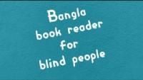
Demonstration

Slide 48
Thank you

Slide 49
Questions ?

Slide 50
Hardware Demonstration
Group 4
Bangla Book reader for blind people
Presented by
Shahir Abdullah 201714054
Nazifa Hamid 201714044
Muhammad Zubair Hasan 201714041
Shariar Azad 201714037
Takik Hasan 201714038

Slide 51

Let’s see the demonstration first !

Slide 52
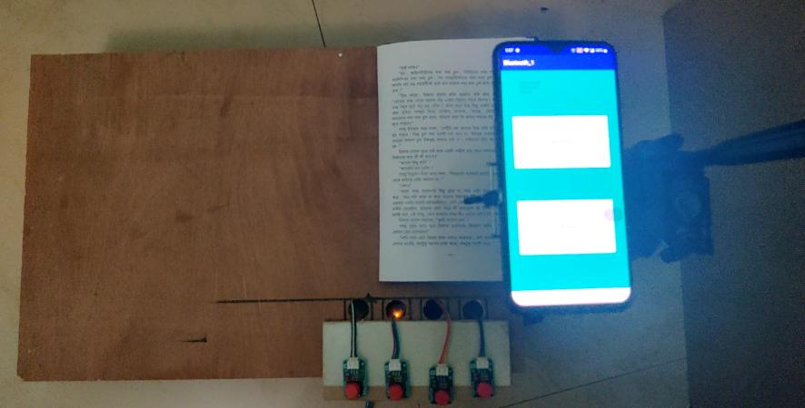

Slide 53
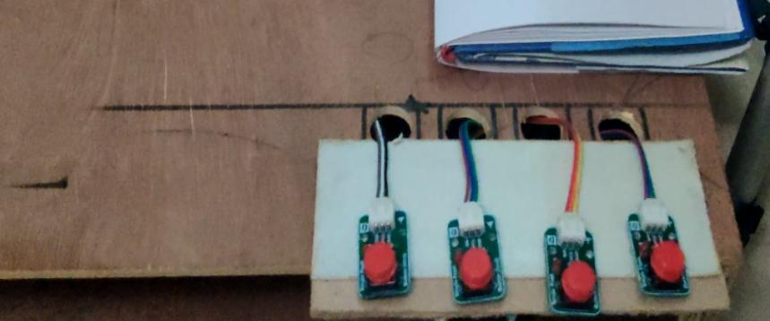

Slide 54
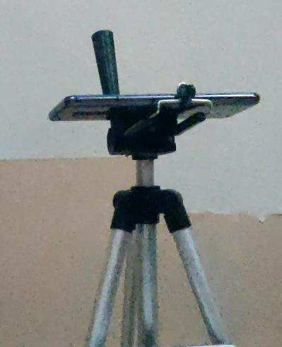
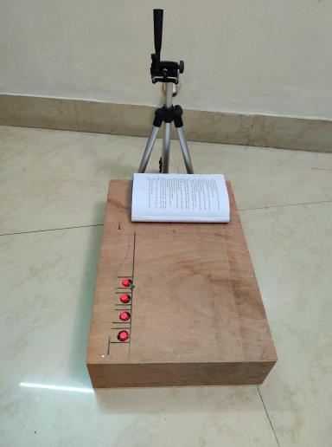

Slide 55
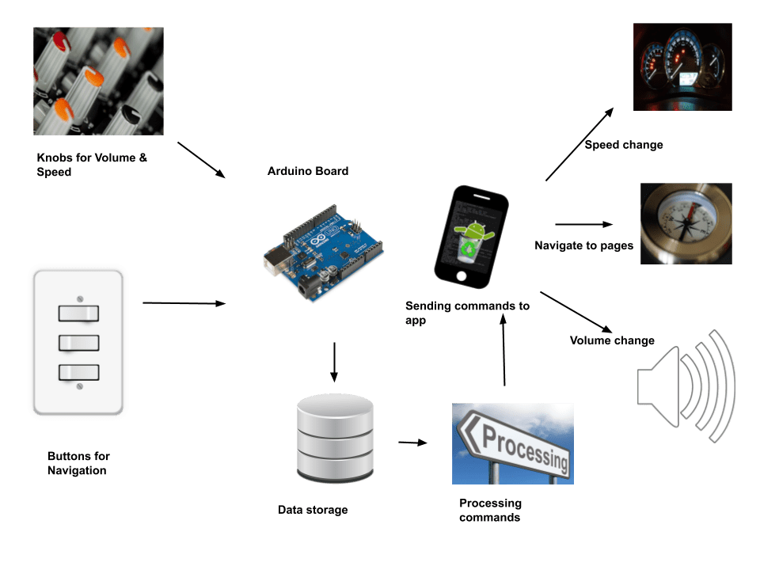
System architecture

Slide 56
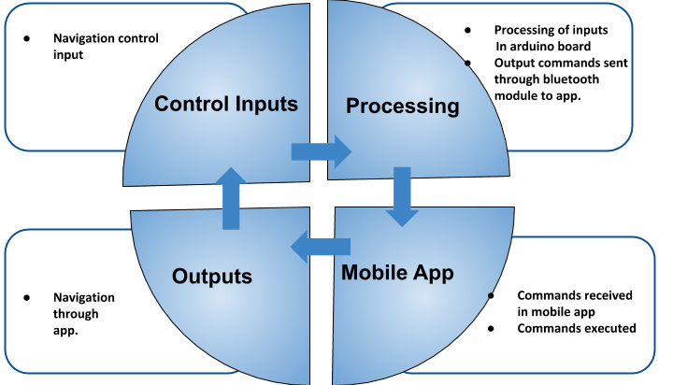
Conceptual diagram

Slide 57
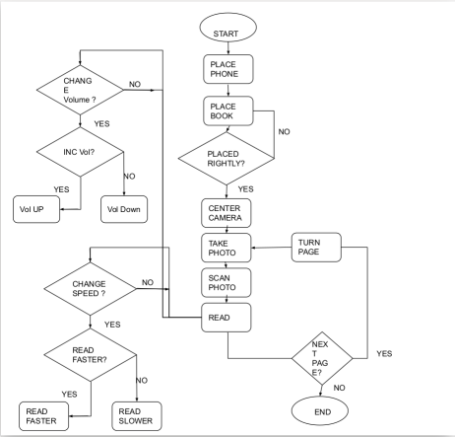
Workflow

Slide 58
Our strengths
Our weaknesses
Flawless command transmission.
No data loss.
Takes only 5v with .6 amp current to run the arduino
Voice command for navigation.
The book holder box is quite heavy.

Slide 59
Goals we reached
Goals we couldn’t reach
Integrating hardware buttons for navigation
Using a stand for holding the camera
Building a placeholder box for the book
Make buttons for taking the picture automatically.
Designing our own camera stand for better positioning.
Testing the project with a blind person.

Slide 60
Goals we found out to be unnecessary
Goals we found out to be necessary
Adding volume control knob button.
Adding speed control knob button.
Adding voice commands for navigation
Adding Bangla voice commands

Slide 61
Q/A

